Slide 1

Back To
MULTI CREDENTIAL ISSUANCE &
PRESENTATIONS
Funded by the Ontario Government
1st February 2023
Mike Richardson I Senior Blockchain Engineer
mike.richardson@northernblock.io I +40 733 012 280
http://www.northernblock.io
Geomina Turlea I geominat@gmail.com I +40 721 151 298
http://www.onemillionyearsbc.io/
and Proprietary.
© Copyright Northern Block Inc. All Rights Reserved.
Notes:
1

Slide 2

INTRODUCTION
SUMMARY
ISSUANCE IN MORE THAN ONE FORMAT
  AnonCreds/JsonLd (W3C) Formats
MULTI FORMAT PRESENTATIONS
  AnonCreds /JsonLd Presentations
MULTI QUERY PRESENTATION EXCHANGE
  PEX Submission Requirements / Input Descriptors
Notes:
2

Slide 3
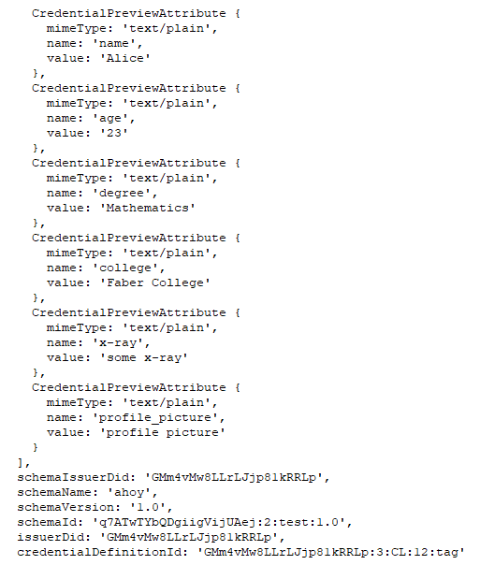
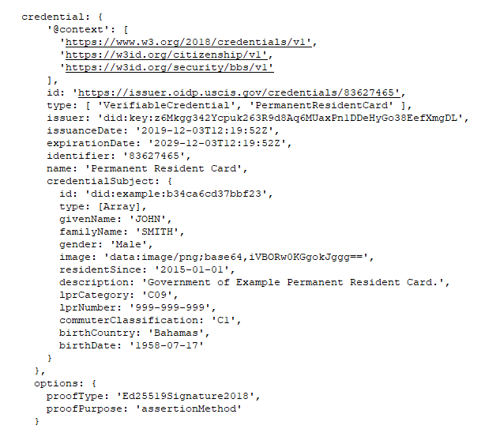
ISSUANCE
MULTI-FORMAT ISSUANCE (AFJ)
Wallet
Storage
CredentialExchangeRecord
AnonCreds
Credential
Issue Credential V2
JsonLd (W3C)
Credential
DIDCommMessage Repository
credentialRecordId
credentialRecordId
AnonCreds
Credential
JsonLd
Credential
V2 Credential message
Notes:
3

Slide 4
PRESENTATIONS
MULTI-FORMAT
PRESENTATIONS (AFJ)
AnonCreds
JSON-LD / PeX
input_descriptors
Requested Attributes
Requested Predicates
Presentation Definition:
[ input_descriptors ]
fields
schema
group
Credentials can be
issued together
or separately
Wallet
Storage
Proof Request
V2
ProofExchangeRecord
Issued
Credentials
Presentation
V2
DIDCommMessage Repository
ProofRecordId
ProofRecordId
V2 Presentation
message
AnonCreds
Presentation
PeX-JsonLd
Presentation
verifiable
credentials
proof
attributes
predicates
proof
presentation_submission
Notes:
4

Slide 5
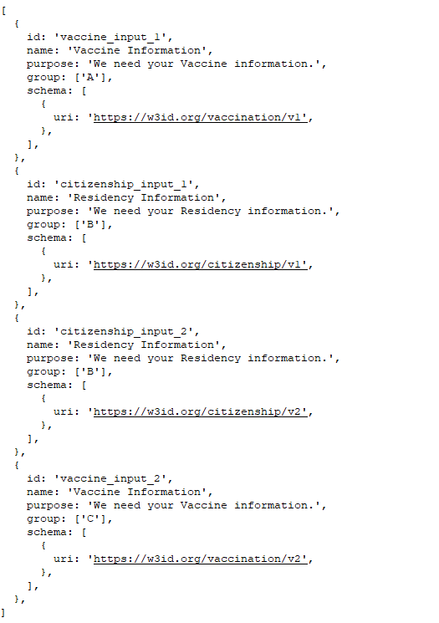
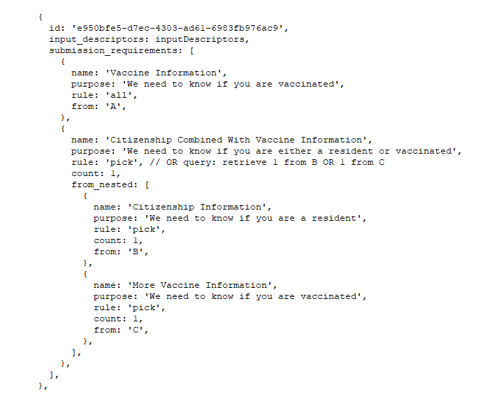
PEX RULES
MULTI-QUERY PRESENTATION
EXCHANGE
Credential 1
Group A
Credential 2
Group B
Credential 3
Group B
JSON-LD / PeX
Presentation Definition:
[ input_descriptors ]
[ submission_requirements ]
Credential 4
Group C
Rules syntax states:
“present all credentials from Group A
And one credential from either Group B OR Group C”
Notes:
5

Slide 6
PRESENTATIONS
MULTI-QUERY PRESENTATION
EXCHANGE
input_descriptors
JSON-LD / PeX
fields
schema
group
Presentation Definition:
[ input_descriptors ]
[ submission_requirements ]
submission_requirements
rules
Credentials can be
issued together
or separately
Wallet
Storage
Proof Request
V2
ProofExchangeRecord
Issued
Credentials
Presentation
V2
DIDCommMessage Repository
ProofRecordId
V2 Presentation
Message
PeX-JsonLd
Presentation
verifiable
credentials
proof
presentation_submission
Notes:
6

